Slide 1
Experimenting an approximation algorithm for the LCS
Paola Bonizzoni, Gianluca Della Vedova and Giancarlo Mauri
Discrete Applied Mathematics, Vol. 110, pp. 13-24, 2001
Date: Feb. 20, 2008
Introducer: Chung-Han Chiang

Slide 2
Abstract(1/2)
The problem of finding the longest common subsequence (lcs) of a given set of sequences over an alphabet Σ occurs in many interesting contexts, such as data compression and molecular biology, in order to measure the “similarity degree” among biological sequences. Since the problem is NP-complete in its decision version (i.e. does there exist a lcs of length at least k, for a given k?) even over fixed alphabet, polynomial algorithms which give approximate solutions have been proposed.

Slide 3
Abstract(2/2)
Among them, Long Run (LR) is the only one with guaranteed constant performance ratio. In this paper, we give a new approximation algorithm for the longest common subsequence problem: the Expansion Algorithm (EA). First of all, we prove that the solution found by the Expansion Algorithm is always at least as good as the one found by LR. Then we report the results of an experimentation with two different groups of instances, which show that EA clearly outperforms Long Run in practice.

Slide 4
Input & Output
Input: a set of sequences
Output: approximation of a LCS ( Longest Common Subsequence)

Slide 5
Introduction
LCS (Longest Common Subsequences)
cs ( aabbcabca, bbcaabcba ): ab, bc, ca, bbc, bca…
LCS ( aabbcabca, bbcaabcba ) = bbcabca
Long Run (LR) Algorithm
  s₁ = GCCGAAGTGGCT (2A 5G 3C 2T)
  s₂ = AGCTACAGTGCT (3A 3G 3C 3T)
  s₃ = AGACATGTACGA (5A 3G 2C 2T)
  s₄ = ACGCAAGTGAGC (4A 4G 3C 1T)
  min: (2A 3G 2C 1T)
  t′ = GGG
  Note: t = GCAGTC
¼-approximation algorithm over Σ = {A,G,C,T}, time complexity: O(kn)
long run symbol

Slide 6
Preliminaries(1/2)
basic sequence: length k over Σ is a sequence σ¹… σ^{k} , with σ^{i} ∈ Σ for all 1≦i≦k and σ^{i}≠σ^{i+1} for all i, 1≦i＜k;
alphabet:{ a , b , c }
ab, ac, ba, bc, ca, cb
ζ:{ (aabbaabcbc) , (abbbbcbbabbaa) , (bcabbbab) }
ζ:{ (a²)(b²)(a²)(b¹)(c¹)(b¹)(c¹) , (a¹)(b⁴)(c¹)(b²)(a¹)(b²)(a²) , (b¹)(c¹)(a¹)(b³)(a¹)(b¹)}
σ^{i}: the sequence of length i only the symbol σ
stream: A stream of a set S ζ of sequences is a basic sequence that is a common subsequence of ζ.
run: The run of a sequence is the maximum length of one of its blocks.

Slide 7
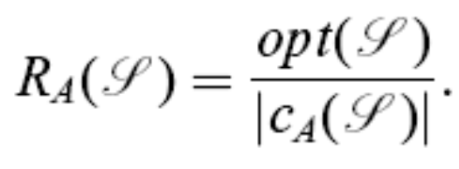
Preliminaries(2/2)
Real LCS length
the solution by an approximation algorithm
R_{A}: performance ratio of the algorithm over an instance ζ is the value R_{A}(ζ)

Slide 8
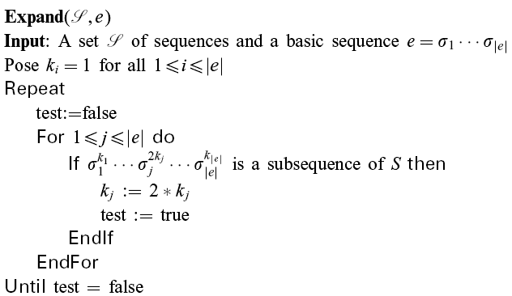
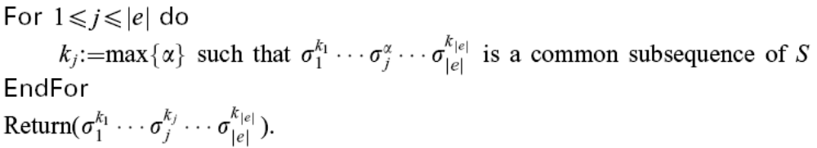
The Expansion Algorithm
Time complexity: O(nm²logm)

Slide 9
Example
ζ:{ (a⁴b³a⁴b²a) , (a³b⁴a⁴b³) } → stream: abab
abab
a²bab
a²b²ab
a²b²a²b
a²b²a²b²
a²b²a⁴b²
double step is over
a²b²a⁴b²
a³b²a⁴b²
a³b³a⁴b²
return the a³b³a⁴b²
The basic idea on which the Expansion algorithm relies is computing the lcs of a set ζ of sequences from a set T of streams of ζ, where each sequence x in T is expanded by the Expand procedure.

Slide 10
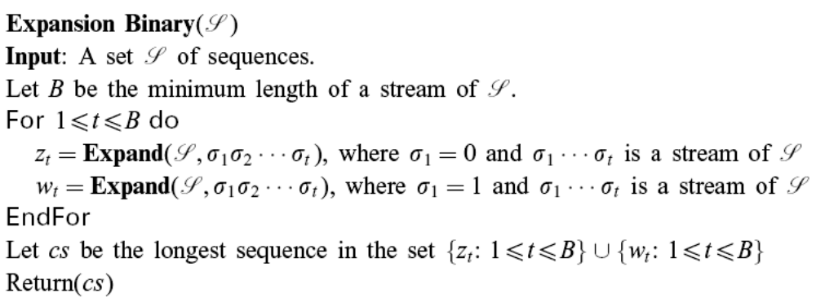
Binary Alphabet
Time complexity: O(nm³logm)
Example
ζ:{ (a⁴b³a⁴b²a) , (a³b⁴a⁴b³) , (b³a²b²a⁷b) , (b⁵a³ba⁸) }
→ stream: abab and baba, Expand( abab ),Expand( baba )
→ (a³b³a⁴b²) (b³a²ba⁷) is the cs, return (b³a²ba⁷)

Slide 11
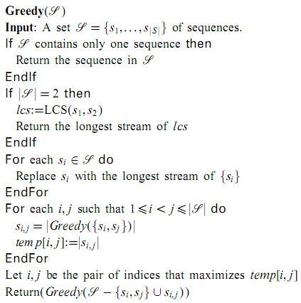
Arbitrary Alphabet
Time complexity: O(nm⁴logm)

Slide 12
Example
ζ:{ (a²b²cabca) , (b²ca²bcba) , (cacacb²cb) , (abcacbacb) } → the LCS of C(4,2) sequences combination: acacbcb
ζ:{ (a²b²cabca) , (b²ca²bcba) , (acacbcb) }
→ the LCS of C(3,2) sequences combination: b²cabca
ζ:{ (b²cabca) , (acacbcb) }
→ the LCS of (b²cabca) , (acacbcb) : cabc, return cabc

Slide 13
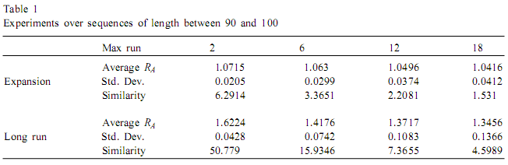
Experimental analysis(1/2)
First group: 4 random sequences of length between 90 and 100.
similarity: the number N(ζ) of blocks of a lcs over the set ζ of sequences to the number A(ζ) of blocks of the approximate solution: where E( ) is the expectation.

Slide 14
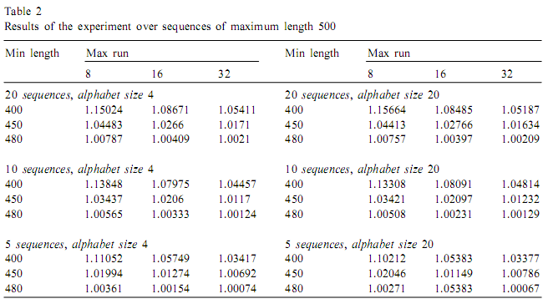
Experimental analysis(2/2)
Second group: sequences of maximum length 500 and alphabets of sizes 4 and 20.

